Slide 1
Humanities Commons:
Scholarly Communication as Sharing
Mariana Ou
13 November, 2017
#CityLIS

Slide 2
#WorldKindnessDay
The meaning of Sharing today,
and its pervasiveness throughout the digital environment
John, N. (2016). Sharing. In: Peters, B., ed., Digital Keywords: A Vocabulary of Information Society & Culture. Princeton: Princeton University Press.

Slide 3
The promise of sharing is at least twofold. On the one hand, there is the promise of honest and open (computer-mediated) communication between individuals; the promise of knowledge of the self and of the other based on the verbalisation of our inner thoughts and feelings. On the other hand, there is the promise of improving what many hold to be an unjust state of affairs in the realms of both production and consumption; the promise of an end to alienation, exploitation, self-centred greed, and breathtaking wastefulness.
(John, 2016)

Slide 4
June 1994: Stevan Harnad’s ‘subversive proposal’
the scientific journal and the scholarly monograph are threatened by rising costs, rising output, and constrained academic budgets. The most painful paradox is that in the interests of science, the law of the market cannot be allowed to function. An item with a very small market may yet be the indispensable link in a chain of research that leads to a result of high social value.
Fitzpatrick, K. ‘Giving It Away: Sharing and the Future of Scholarly Communication’
http://www.plannedobsolescence.net/giving-it-away/

Slide 5
2002: Budapest Open Access Initiative
2003: Berlin Declaration on Open Access to Scientific Knowledge
“Open access,” that is, means free access not just in the sense of “gratis,” work made available without charge, but also in the sense of “libre” – work that, subject to appropriate scholarly standards of citation, is free to be built upon. This is the
cornerstone of the scholarly project: scholarship is written to be read and to influence more new writing.
Fitzpatrick, K. ‘Giving It Away: Sharing and the Future of Scholarly Communication’
http://www.plannedobsolescence.net/giving-it-away/

Slide 6
Open Access
…work is more cited than if published in traditional closed venues
…facilitates traditional researcher access
…reaches a much broader range of readers
…increases the discoverability of scholarly work on the web
only through open dialogue across the walls of the ivory tower will we have any
chance of convincing the broader public, including our governmental funding bodies,
of the importance of our work
Fitzpatrick, K. ‘Giving It Away: Sharing and the Future of Scholarly Communication’
http://www.plannedobsolescence.net/giving-it-away/

Slide 7
Open access publishing is far more in keeping with the core values
of the scholarly enterprise:
From costs to values
Fitzpatrick, K. ‘Giving It Away: Sharing and the Future of Scholarly Communication’
http://www.plannedobsolescence.net/giving-it-away/

Slide 8
2001: Creative Commons
Creative Commons helps you legally share your knowledge and creativity to build a more equitable, accessible, and innovative world. We unlock the full potential of the internet to drive a new era of development, growth and productivity.
https://creativecommons.org
Video: https://www.youtube.com/watch?v=8YkbeycRa2A

Slide 9
Fitzpatrick’s ’shifts in authorship’:
from product to process
from individual to collaborative
from originality to remix
from intellectual property to the gift economy
from text to… something more
Fitzpatrick, K. (2011). Planned obsolescence: publishing, technology, and the future of the academy. New York: New York University Press.

Slide 10
What if we understood sustainability not as the ability to produce revenue, but the ability to keep the engine of generosity running?
What if we were to allow the engine of generosity on which so much of the enterprise runs to affect the final point of distribution, if we were to embrace the gift economy of scholarly communication and make a gift of our work to others? What might happen if outreach, generosity, giving it away were our primary values?
Fitzpatrick, K. ‘Giving It Away: Sharing and the Future of Scholarly Communication’
http://www.plannedobsolescence.net/giving-it-away/

Slide 11
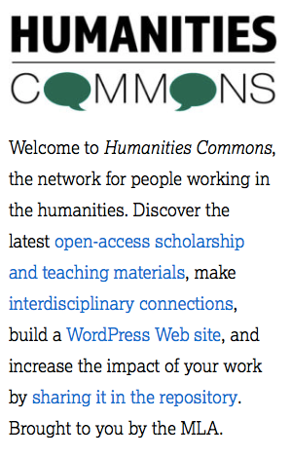
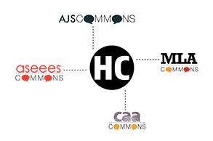
Video:
https://www.youtube.com/watch?v=tYV6QI63rbc&t=325s

Slide 12
https://hcommons.org/
What can I do on Humanities Commons?
Build a personal or collaborative WordPress site
Start or join a discussion group: totally hidden and private, invite-only, or public
Deposit materials in the open-access repository (and get a DOI for what you deposit)
Archive your work for future generations
Support a not-for-profit alternative to venture capital & publisher-funded networks
Video: https://www.youtube.com/watch?v=FgXBuOZxBDs

Slide 13
https://hcommons.org/
What can I share in CORE?
Articles Bibliographies Blog Posts Code Dissertations Documentaries
Fictional works Images Interviews Journalism Maps Music Poetry
Open educational resources Poetry Reports Syllabi Theses Translations
Video Visual Art White papers ...
Video: https://www.youtube.com/watch?v=FgXBuOZxBDs

Slide 14
https://hcommons.org/
CORE Top 20 by downloads (July 2016)
6 peer-reviewed articles 5 conference papers 3 book chapters 3 syllabi 1 set of course materials 1 op-ed 1 thesis
By 6 full professors 5 ‘alt-acs’ (2 librarians, 2 MLA staffers, 1 DH director) 4 associate professors 3 graduate students 1 assistant professor 1 adjunct
Video: https://www.youtube.com/watch?v=tYV6QI63rbc&t=325s

