Slide 1
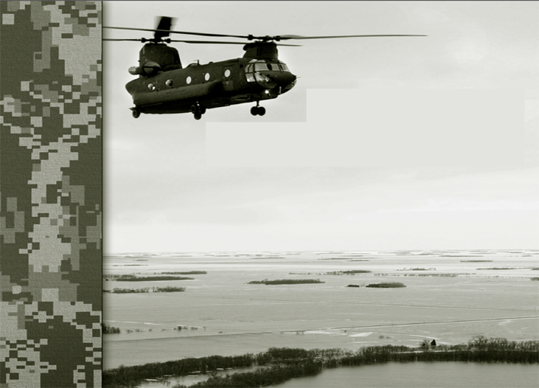
DSCA Handbook Tactical Level
Commander and Staff Toolkit
(GTA 90-01-020)
GTA 90-01-021
30 July 2010

Slide 2

5.11 Chaplain 5-47 thru 5-53
Civilian counterpart(s): Local Clergy, Priests, Chaplains, Rabbis, Imams, etc. No Incident Command System (ICS) counterpart.
Joint Publication (JP) 1, Doctrine for the Armed Forces of the United States, states that military commanders as responsible to provide for the free exercise of religion of those under their authority.
JP 1-05, Religious Affairs in Joint Operations, defines the concept of ―religious affairs as consisting of two major capabilities of chaplains—religious advisement and religious support.
  Religious Advisement is the practice of informing the commander on the impact of religion on joint operations to include, but not limited to: worship, rituals, customs and practices of U.S. military personnel, international forces, and the indigenous population.
  Religious Support is Chaplain facilitated free exercise of religion through worship, religious and pastoral counseling services, ceremonial honors for the dead, crisis intervention, and advice to the commander on matters pertaining to morals, ethics, and morale as affected by religion.

Slide 3
JP 3-28, Civil Support (CS), defines Religious Support (RS) as the full spectrum of professional duties performed by chaplains in their dual role as religious leaders and military officers. RS in joint operations is dedicated to meeting needs of military and other authorized members in the personal free exercise of religion and providing commanders with professional advice regarding the dynamic influence of religion and religious belief in the operational area. The purpose of a Religious Support Team (RST) is to provide for, develop, and strengthen the spiritual and moral well-being of all members of the command.
Military chaplains, assisted by enlisted chaplain assistant support personnel, provide RS as part of a RST, which normally consists of at least one chaplain and one enlisted support person.
The RST deploys during CS operations for the primary purpose of providing RS to authorized DoD personnel. In this context, DoD personnel are military members, their families, and other authorized DoD civilians (both assigned and contracted) as determined by the Joint Force Commander (JFC).

Slide 4
The Establishment Clause of the United States Constitution and current DoD legal guidance generally prohibits chaplains from providing RS to the civilian population. However, following certain rare and catastrophic large-scale disasters, local and state capabilities of all types, to include spiritual care, may be overwhelmed. In these situations RSTs may serve as liaison to Non-Governmental Organizations (NGOs) and Faith-Based Organizations (FBOs) when directed by the JFC.
Incidental support may be provided to persons not affiliated with the Armed Forces during the execution of an authorized mission when the following four criteria (known as ―the Four Prong Test) are met:
  1. The support must be individually and personally requested in an emergency situation, whereby the need is immediate, unusual, and unplanned.
  2. The need must be acute. Acute needs are those which are of short duration, prone to rapid deterioration, and in need of urgent and immediate care. The necessary provision of ―last rites is the clearest, but not the only example of such needs.
  3. The requested support must be incapable of being reasonably rendered by members of the clergy unaffiliated with the Armed Forces. Time, distance, and the state of communications may require such a determination to be made on the spot, by the chaplain, based on the information available at the time.
  4. The support must be actually incidental. Such support incurs no incremental monetary cost and does not significantly detract from the primary role of the RST.

Slide 5
DoD and National Guard (NG) chaplains are religious ministry professionals with training, education, and experience comparable or equivalent to the certifications standards of organizations active in disaster response. RST personnel should have training in Crisis Intervention Management tools such as Psychological First-Aid, Critical Incident Stress Management (CISM), Group Crisis Intervention and Disaster Mental Health, and should be thoroughly familiar with DoD Directive (DoDD) 6490.5, ―Combat Stress Control (CSC) Programs, as well as Field Manual (FM) 4-02.51, Chapter 6, ―Traumatic Event Management and Air Force Instruction (AFI) 44-153, Traumatic Stress Response.
All of the branches have respective guidance on CSC Programs developed from DoDD 6490.5. The Army's Program is found in FM 4-02.51, Combat and Operational Stress Control. FM 1-05, Religious Support specifically outlines the use of "Critical Event Debriefing" built on CISM. The Air Force has AFI 44-153, Traumatic Stress Response. The Navy has the Navy Leader's Guide for Managing Personnel in Distress. The Marine Corps has the Leaders Guide for Managing Marines in Distress. For additional resources, refer to the webpage http://www.pdhealth.mil/op_stress.asp

Slide 6
Training for these programs is available in multiple places, including NGB Office of the Chaplain (NGB-OC). Service-specific chaplain training is available at the Armed Forces Chaplaincy Center (the new Joint Service Chaplain School) at Fort Jackson, South Carolina, where all Service chaplain schools are located. Other Crisis Intervention Training can be obtained through the International Critical Incident Stress Foundation, the American Red Cross (Spiritual & Emotional Care), and the National Organization for Victim Assistance Crisis Response Team Training. Other training includes Suicide Prevention, Resilience Training (formerly Battlemind), Landing Gear, and Strong Bonds.
During CS operations, military units operate in religiously diverse civilian communities, and chaplains must be willing to support and serve a religiously diverse, pluralistic population.
As a primary mission, the RST will support the command to which assigned. Pursuant to a commander‘s orders or religious support plan, the RST may also be responsible for providing joint area RS to units without assigned chaplains and to personnel from low density faith groups. A NG RST in State Active Duty or Title 32 status may provide RS to Active Component personnel during emergency circumstances.

Slide 7
Coordination and collaboration between DoD chaplains and civilian clergy, religious ministry professionals, and caregivers enhances mission success, the recovery process and situation awareness. Response and recovery following disasters and catastrophic events will require all local, state, tribal, federal, and non-governmental resources working in a cooperative partnership.
The NG, under the command of the governor or The Adjutant General (TAG) will generally be the first to respond to a natural or man-made disaster. The Joint Force Headquarters (JFHQ)-State chaplain is responsible for coordinating RS for NG forces serving in State Active Duty or Title 32 status. NG forces coordinate disaster response with the NGB-OC. Combatant Command chaplains and Joint Task Force (JTF) chaplains will coordinate chaplain activities with NGB-OC and involved JFHQ-State chaplains, to the maximum extent possible, to ensure collaboration and cooperation. In particular, Combatant Command chaplains coordinate chaplain response with NGB-OC.

Slide 8
Local, county, and state resources, including National Guard forces under Title 32, normally constitute the first line of response to crisis management and consequence management events.
The JTF chaplain will be responsible for coordinating the activities of DoD chaplains, as well as the activities of civilian chaplains, clergy, and religious ministry professionals supporting the DoD community, which is normally conducted through civil-military operations centers. National coordination efforts are needed to build partnerships between DoD chaplains and civilian clergy, religious ministry professionals, and other agencies responding to disasters.
Chaplains facilitate a return to normalcy and restoration of trust. Military chaplains can work cooperatively and collaboratively to build partnerships with Faith-Based Organizations (FBOs) and civilian chaplains in order to facilitate the delivery of humanitarian care to the effected population. Emergency spiritual and emotional care, traumatic incident management, respecting and honoring the dead, and other religious activities are critical to sustaining

Slide 9
Lessons Learned from Hurricane Katrina 1. Units must ensure that adequate ministry services are available to their personnel and personnel of supported units. 2. Units must carefully and tactfully avoid requests from other relief organizations for ministry services, if supporting such requests will drain necessary resources from military personnel in the AO. 3. Behavioral health resources should be made available to military personnel involved with recovery of human remains. 4. If behavioral health assets are not sufficient to support personnel involved with the recovery of human remains, chaplain/pastoral or other counseling resources can and should be used until additional assets are available. 5. RSTs should be prepared to deploy during humanitarian relief operations and to operate in all conditions in order to provide support to their units.

Slide 10
5.11.1 Chaplain Phase 1 - Assessment and Preparation/Mobilization
Establish RSTs to provide religious support to authorized DoD personnel and their families.
Plan for operations and secure deployment of liturgical supplies.
During mass casualty events, identify coordination and planning requirements for chaplain activities in coordination with Medical Officer, civilian care providers, the Red Cross, and other civilian agencies.
Coordinate with civilian ministry organizations providing support.
Identify coordination and planning requirements between Service Component, National Guard, United States Coast Guard (USCG), civilian chaplains and clergy.
Review Area of Responsibility (AOR) demographics to anticipate chaplain faith and denominational balance.
Plan for religious services.

Slide 11
5.11.2 Chaplain Phase 2 - Deployment
Service Components will identify, mobilize and/or deploy religious support personnel who meet deployment standards.
Be aware that DoD Mortuary Affairs personnel may be tasked to assist other government agencies in the collection and processing of civilian casualties.
Maintain situational awareness of stress levels of assigned DoD personnel, first responders, and affected civilians, and take actions to provide care and mitigate stress.
Provide stress level situational awareness reports to the commander.
Be prepared to deploy with a minimum of 30 days of chaplain supplies.

Slide 12
5.11.3 Chaplain Phase 3 - Support of Civil Authorities
Be prepared to conduct crisis intervention or CISM training/services.
Chaplains in supervisory positions will coordinate with appropriate staff agencies to ensure that subordinate chaplains and enlisted religious support personnel receive appropriate support and professional guidance.
When directed, conduct liaison and coordinate activities with other units.
Coordinate with NGOs and other agency religious personnel.
Provide religious support to authorized DoD personnel and focus on mitigating the impact of traumatic events.

Slide 13
5.11.4 Chaplain Phase 4 - Re-deployment/Demobilization
Be prepared to conduct critical event debriefings or other CISM requirements.
RSTs advise the command on indicators, documenting civilian community capabilities to resume normal functioning without military support.
RSTs conduct re-deployment religious support to assigned personnel and their families, focusing on reunion and reintegration issues with families.
Prepare AAR comments and document lessons learned.

